Slide 1
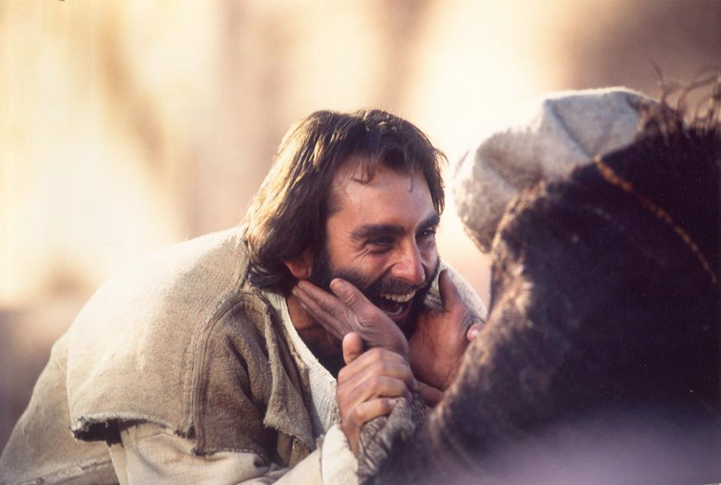
Giving That God Rewards
Matthew 6:1-4
Dr. Rick Griffith, Crossroads International Church Singapore
www.BibleStudyDownloads.org

Slide 2
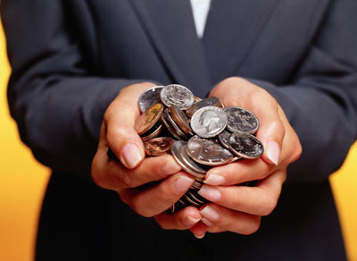
What results from giving to God?
Notes:
What results from giving to God? For the next 30 seconds, ask the person next to you to see what he or she thinks!
Need: Do you ever wonder what results from your own giving?
Do you end up wealthier by giving to God?
Do you become poorer by giving to God?
Is there no difference at all in your life whether you give or not?
Should we even care about such things like the result of our giving? Well, I going to assume that you do care because so many people give so little, but you give much of your money and might wonder about our question for today…

Slide 3
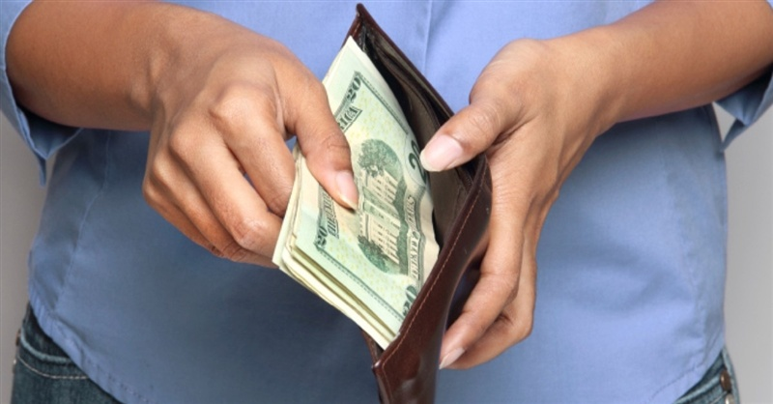
How can you be rewarded in your giving?
Notes:
In what ways can the parting of you and your money actually benefit you?

Slide 4
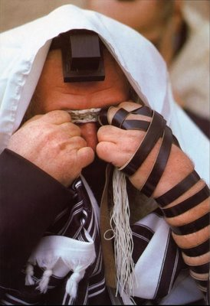
The Sermon on the Mount
Pharisee Teaching (Matthew 5)
Pharisee Practice (Matthew 6)
Notes:
We've been studying Jesus in his famous Sermon on the Mount where he had just finished telling the crowd to love their enemies.
• That ended chapter 5 where he kept saying, "You have heard that it was said…" when he compared the Pharisee view of external righteousness with the genuine, internal purity God requires. In Matthew 5 Jesus speaks critically of the teaching of the Pharisees.
• In Matthew 6 Jesus begins to talk not about the proverbs of the Pharisees but about their practice—not their doctrine but their deeds.

Slide 5
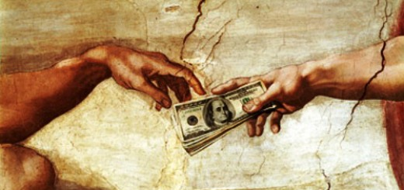
"Show me your finances and I will tell you your priorities."
Notes:
Someone wisely said, "Show me your finances and I will tell you your priorities." Jesus spoke about money more than any other subject because he wanted to get to the heart of what we value.

Slide 6
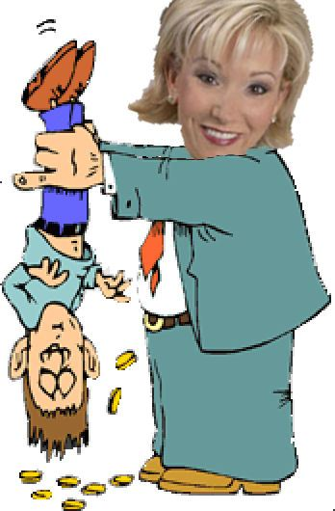
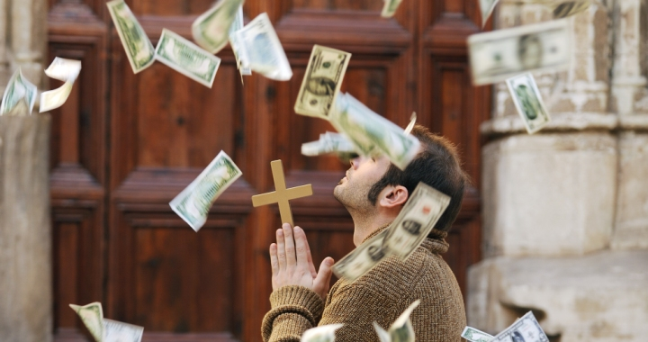
The "Prosperity Gospel"
Notes:
Sometimes pastors like me are afraid to speak about giving because
• listeners might think we are prosperity teachers, but if we preach straight through what Jesus said, eventually we will get to what he says about our money.

Slide 7
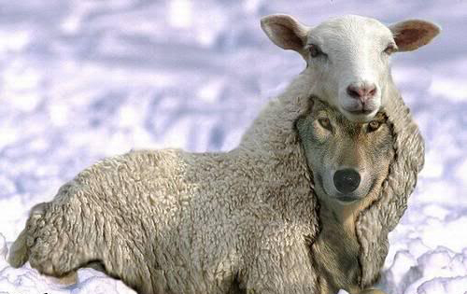
Prosperity teachers are wolves in sheep's clothing
Notes:
I thought about continuing sharing what Christ said in the Sermon on the Mount last week, but since it was Easter, I chickened out about talking about giving! Susan said she'd boycott church if I didn't preach on the resurrection. As it turned out, she didn't come anyway as she was teaching our children's class about a risen Savior.

Slide 8

"Show mercy…with cheerfulness"
(Rom. 12:8).
Notes:
But we are commanded to make disciples, and no discipleship is complete without addressing what we do with the funds that we consider our own—even though the ability even to earn money comes from God, as does the money itself!

Slide 9

How NOT to Give (1-2)
How to Give (3-4)
Notes:
Today we'll first see how not to give (1-2) followed by how to give (3-4).

Slide 10
How can you be rewarded in your giving?
Notes:
Matthew 6:1-4 shows how you can be rewarded in your giving.
Even if you give publicly there still is some reward, for Jesus says that…

Slide 11
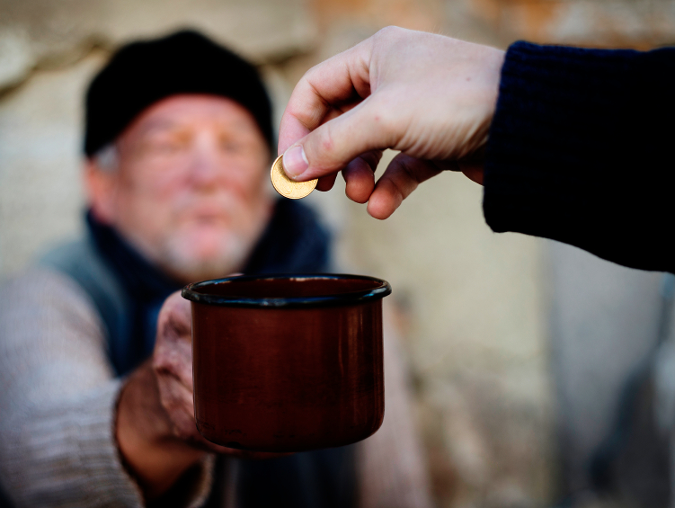
I. People praise public giving (6:1-2).
Notes:
Blessing others for show only blesses you before others.

Slide 12
"Be careful not to do your 'acts of righteousness' before men, to be seen by them. If you do, you will have no reward from your Father in heaven"
(6:1 NIV).
"Watch out! Don't do your good deeds publicly, to be admired by others, for you will lose the reward from your Father in heaven"
(6:1 NLT).
Notes:
Jesus warned us not to show off our good deeds (6:1a).
What kinds of good deeds for show does Jesus mean in verse 1?
The following verses warn against public show in almsgiving, prayer, fasting, investing, faith and humility!
Each of these actions is actually a good practice. However, if we do it for men rather than for God, we are rewarded on earth rather than in heaven!
These "acts of righteousness" are vertical, not horizontal. "Righteousness is not primarily a matter between a person and others, but between a person and God. So one's acts should not be demonstrated before others for then his reward should come from them (vv. 1-2)" (BKC, emphasis his).
How far into the chapter does this warning not to please men apply (1)?
It goes at least to 7:12 to address many issues that we face today that we are tempted to do for human show.
So 6:1 is really a guide for the next several sections—basically ask yourself not what you do but why you do it!

Slide 13

What Christian practices do we sometimes do for show?
Notes:
Wow, the list is endless!
Tell others how much you give to the Lord.
Sing loudly so others around you can hear your beautiful voice.
Sing in harmony to impress the person next to us or in the row in front of us.
Sing with your hands stretched up to the heavens.
Sing things that you would never actually say: "I Surrender All," "Take My Life…"
Pray with urgency and frequently saying God's name.

Slide 14
"Be careful not to do your 'acts of righteousness' before men, to be seen by them. If you do, you will have no reward from your Father in heaven"
(6:1 NIV).
"Watch out! Don't do your good deeds publicly, to be admired by others, for you will lose the reward from your Father in heaven"
(6:1 NLT).
Notes:
The reward for public good deeds is not from God (6:1b).
Will wrong motives cause us not to be rewarded (NIV, NAU) or cause us to lose a reward that we already have (NLT)?
The Greek here just says that we won't have a reward.

Slide 15

Rewards can be lost!
"Watch out that you do not lose what we have worked so hard to achieve. Be diligent so that you receive your full reward" (2 John 8 NLT)
"I have given you an open door that no one can shut" (3:8)

Slide 16

Judgment Seat of Christ
160
Believers Rewarded by Christ (2 Cor. 5:10)
At the Rapture
(1 Thess. 4:17)
Reward or loss of rewards (not salvation)

Slide 17

We will join him in the clouds
(1 Thess. 4:17)

Slide 18
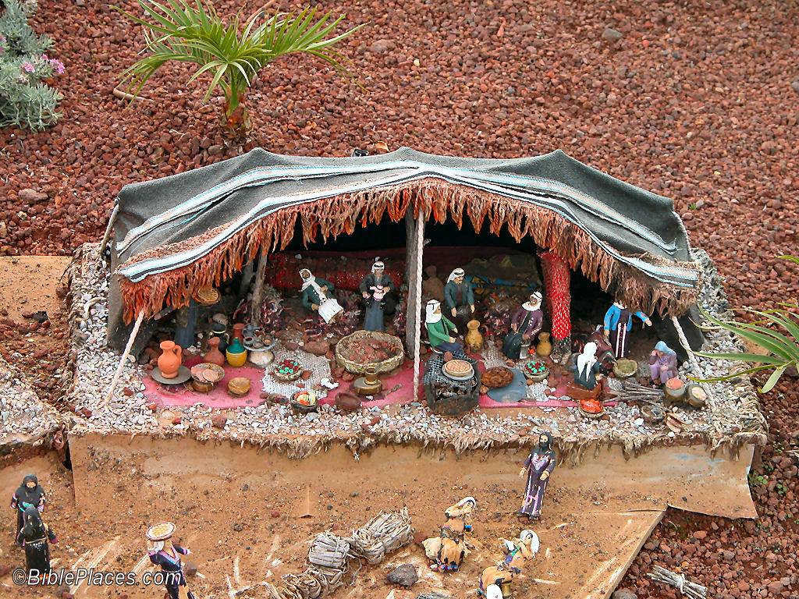
We will put away "this present tent"
(2 Cor. 5:1)

Slide 19
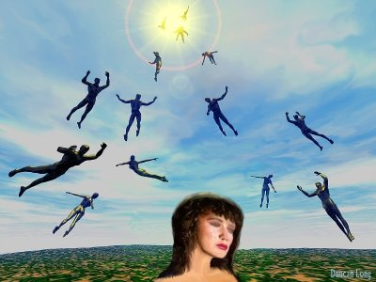
New bodies

Slide 20
The Judgment Seat of Christ
Is this a judgment to determine salvation?
Or is it to reward believers?

Slide 21
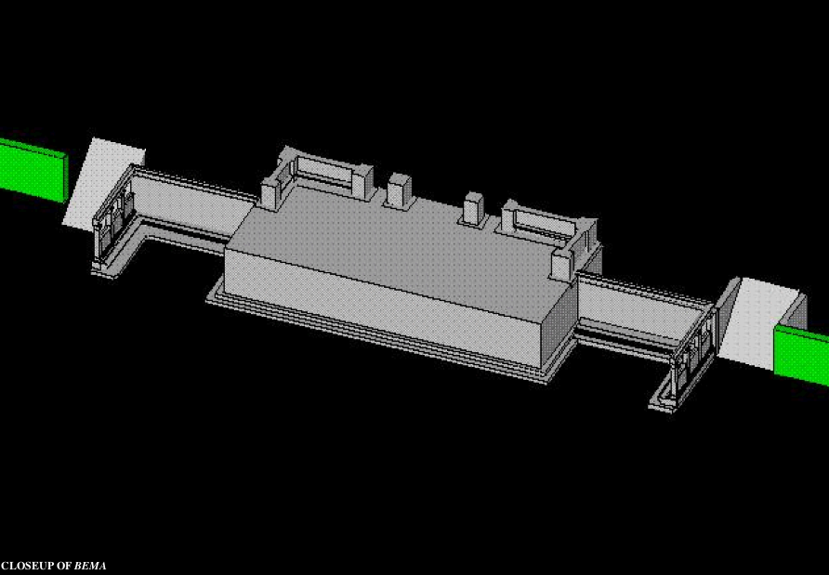
Bema Close-up
"So we make it our goal to please him, whether we are at home in the body or away from it. ¹⁰For we must all appear before the judgment seat [bema] of Christ, that each one may receive what is due him for the things done while in the body, whether good or bad" (2 Cor. 5:9-10 NIV).
Notes:
21
http://corinth.sas.upenn.edu/schola.html

Slide 22
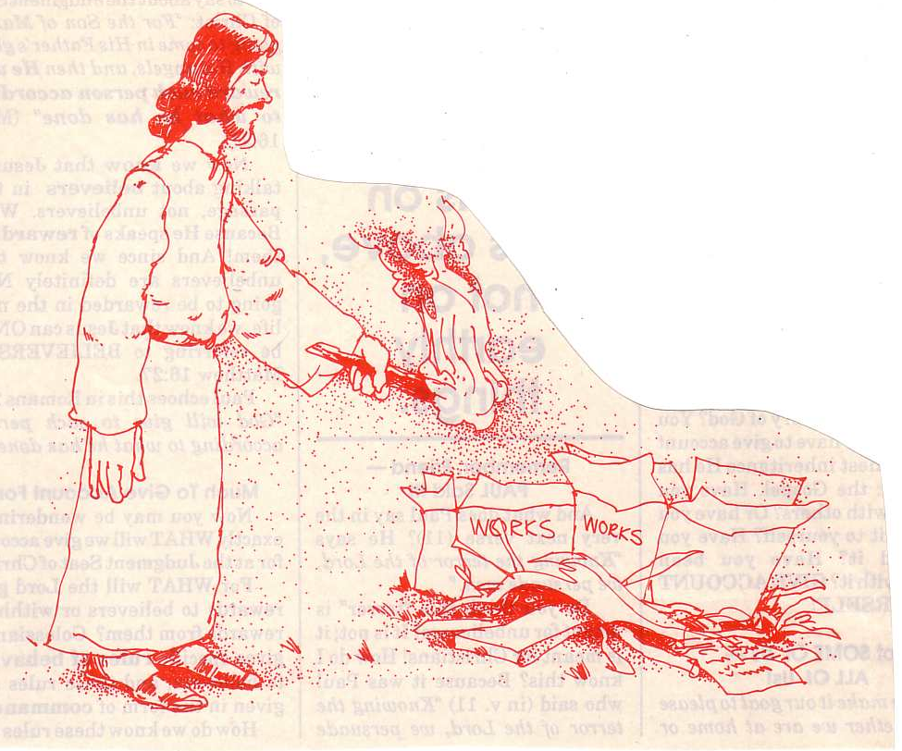
"… the fire will test the quality of each man's work"
(1 Cor. 3:13)
76
Notes:
22
We see in 1 Corinthians 3 that our deeds are either good and lasting (gold, silver, precious stones) or bad and flammable (wood, hay, straw). The good ones will be rewarded.

Slide 23
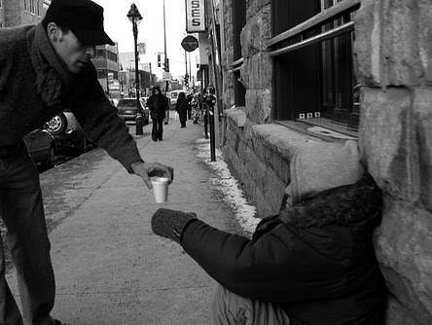
"When you give to someone in need, don't do as the hypocrites do—blowing trumpets in the synagogues and streets to call attention to their acts of charity! I tell you the truth, they have received all the reward they will ever get" (6:2 NLT).
Notes:
The way not to give to the needy is by showing off (6:2a).
The religious teachers of Jesus' day were prosperity teachers.
The Pharisees were rich and gave credit to their piety before God.
As such, they frowned upon the poor as they saw them as less godly and therefore judged with poverty. What a heartless and erroneous theology!

Slide 24

The reward for public giving to needs is only from people (6:2b)

Slide 25
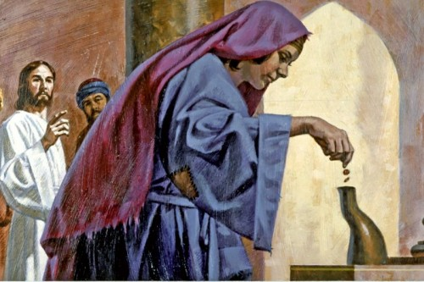
Giving in the Time of Jesus
Notes:
The people were accustomed to giving in a variety of ways:
All gave to the temple treasury through a small hole so that the money ended up going through the wall to those who counted it on the other side. In that sense, it could be quite public—or very anonymous unless one announced it with trumpets!

Slide 26
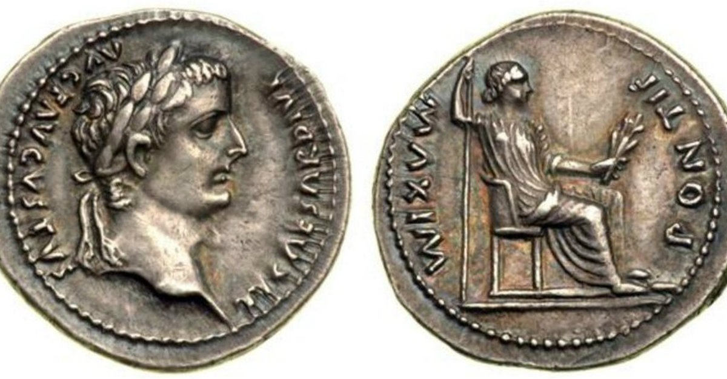
Roman Coins
Notes:
This was the days prior to paper currency, so large gifts generally were in larger bags of coins. Even so, one could go up to the giving "trumpet" and quietly put several bags into the hole while covering up the hole with one's robe.
Of course, there also were coins of various values too—the mite was a small copper coin worth a fraction of a day's wage, the denarius equaled a workingman's daily wage, all the way up to talents of silver and gold.
Jesus also mentioned giving in the synagogues (6:2), so they evidently took an offering there as well.
Some also gave in the streets (6:2), perhaps directly to the poor on the street.

Slide 27
Swallow your pride occasionally.
It's non-fattening!
—Anonymous
Notes:
Many today publicly announce their giving.
I used to attend a church in the USA that published in the bulletin the amounts each person gave the previous week: Joe Smith $1.25, Freda Jones $23.00, etc. I guess they thought it would encourage generosity!
We also have many millionaires and billionaires who publicly declare who they gave to and how much—though for presidential candidates who release them, I think this detail is required in their publicly available tax records.

Slide 28

How might you already have your reward by giving publicly?
Notes:
Who do you hope will see your giving? If you do hope others see it, then consider yourself rewarded right now. Period.
What is really in your heart when you give publicly?
Did Pharisees really blow trumpets to call attention to their giving (2)?
Jesus could be exaggerating here by only meaning that hypocrites want public acknowledgement for their deeds.
However, the text seems to indicate that the leaders actually literally blew trumpets like he noted!

Slide 29

—Warren Wiersbe, Matthew, 56—
"Our sinful nature is so subtle that it can defile even a good thing like sharing with the poor. If our motive is to get the praise of men, then like the Pharisees, we will call attention to what we are doing. But if our motive is to serve God in love and please Him, then we will give our gifts without calling attention to them. As a result, we will grow spiritually; God will be glorified; and others will be helped. But if we give with the wrong motive, we rob ourselves of blessing and reward and rob God of glory, even though the money we share might help a needy person."

Slide 30
How can you be rewarded in your giving?
Notes:
So how can you be rewarded in your giving?

Slide 31
I. People praise public giving (6:1-2).
Notes:
Jesus first told us how not to give so we have a meager, earthly reward. Well, then, how should we give? What's the way to give that receives God's blessing and approval?

Slide 32
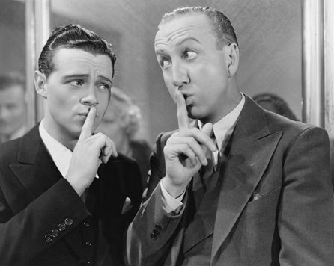
II. God praises private giving (6:3-4).
Notes:
Our all-seeing Lord blesses us when we bless others in secret.

Slide 33

"But when you give to someone in need, don't let your left hand know what your right hand is doing. ⁴Give your gifts in private…" (6:3-4a NLT).
Notes:
What does that mean not to let your left hand know what your right hand is doing (3)?
Our two hands typically work in tandem with each other, knowing what the other one is doing. But that is all above board and evident to all.
If I don't want you to see what I'm doing then I won't even let you see both hands. This gives some measure of secrecy to my good deed.
This figure of speech reminds me of the illusionist who tries to get you to look at the left hand because the right hand is doing the actual trick.
Likewise, we should go to pains to assure that others don't know what we are giving.
We do give online and our treasurer typically knows whose account gave the gift.
But actually, the largest gift we ever received came in 2009. Our monthly offerings were about $6000/month back then, but in May only $3000 came in. Then, on the last Sunday of the month, someone transferred $10,000 into the church bank account, so we had $13,000 in giving that month! To this day I don't know who gave it nor does anyone else—except God. Yet the gift met a real need that month so we could pay all our expenses.
Another idea here is that the right and left hand not informing one another means that the giving is so secretive that the person forgets what he gave (BKC).

Slide 34

What does it mean to give your gifts in private (4a)?
Notes:
Private means to use an offering bag rather than a collection plate so no one can see the amount of your gift—or else put the money in an envelope instead.
Private means not to tell others how much you give.
Private means to have a plan to give so that it is not even known by anyone what your gift amount was.

Slide 35
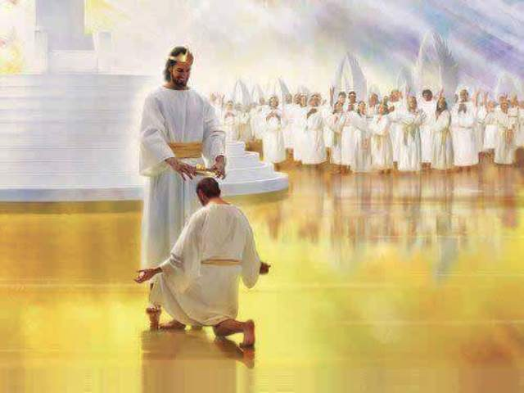
"Give your gifts in private, and your Father, who sees everything, will reward you”
(6:4 NLT).
Notes:
The result of private giving is reward from the God who sees all (6:4b).
Sometimes that reward comes in this life. David said, "Once I was young, now I am old, but I have never seen the righteous forsaken or their children begging for bread." Do you call that prosperity gospel? God prospers those who follow him by meeting their needs but not by making them necessarily rich!
Yet I think that most of our rewards from God will come at the Judgment Seat of Christ at his return. This is also called our "inheritance," which is a fascinating doctrine I'm just beginning to study now. More on this later this year!

Slide 36
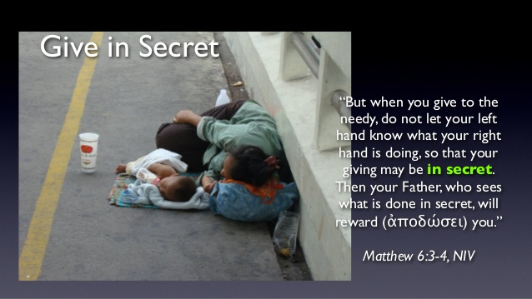
There are creative ways to give privately.
Notes:
Don't tell others how much you give.
Give in cash.
Use the online giving function so only the treasurer knows how much you give. (This is why I want a treasurer, as I should not know who gives what, even though I have access to the church's online banking.)

Slide 37
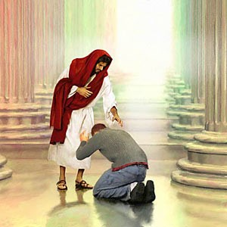
How much should we give God?
Notes:
How much should we give God—for example, should we tithe? What percentage should we give—10%, 20%?

Slide 38
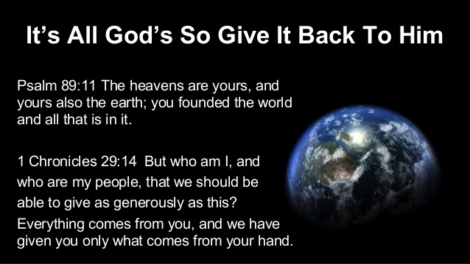
It's All God's So Give It Back to Him
Notes:
My quick answer to this question is that we should give God 100%. Is he worth any less than that?
Of course, you need some to live on, so I suggest that you take care of your needs, save 20% and give the rest to the Lord. For some of us, that remainder might be 10%. For others it might be 20% or more. You need God to tell you the amount that you should keep as well as the amount you should give away.

Slide 39
—Warren Wiersbe, Matthew, 56—
"Does this mean that it is wrong to give openly? Must all giving be anonymous? Not necessarily, for everyone in the early church knew that Barnabas had given the income from the sale of his land (Acts 4:34–37). When the church members laid their money at the apostles' feet, it was not done in secret. The difference, of course, was in the motive and manner in which it was done. A contrast is Ananias and Sapphira (Acts 5:1–11), who tried to use their gift to make people think they were more spiritual than they really were ."
Notes:
Should we never give publicly?

Slide 40
—Warren Wiersbe, Matthew, 56-57—
"Giving alms to the poor, praying, and fasting were important disciplines in the religion of the Pharisees. Jesus did not condemn these practices, but He did caution us to make sure that our hearts are right as we practice them. The Pharisees used almsgiving to gain favor with God and attention from men, both of which were wrong motives. No amount of giving can purchase salvation, for salvation is the gift of God (Eph. 2:8–9). And to live for the praise of men is a foolish thing because the glory of man does not last (1 Peter 1:24). It is the glory and praise of God that really counts!"

Slide 41
How can you be rewarded in your giving?

Slide 42

Main Idea of 6:1-4…
Give in private.
Notes:
Be a secret giver.
Honor by people rewards the showy giver—but the blessing of God himself rewards the stealthy giver.
So how can you be rewarded in your giving? (Subject) Today we've seen that…

Slide 43
I. People praise public giving (6:1-2).

Slide 44
II. God praises private giving (6:3-4).

Slide 45

Do you give, as God would want you to?
What must change in your giving?
The amount?
The attitude?
The consistency?
The recipients?
The secrecy?
Notes:
The amount? Are you giving too little? Probably none of us is giving too much.
The attitude? Have you been giving grudgingly—or cheerfully?
The consistency? Do you have ad hoc giving? I keep track of every dollar given so I make sure I give the percentage I committed to God.
The recipients? Is anyone in need due to your lack of generosity?
Prayer
The secrecy? Might you guard your giving amounts so the glory goes to God alone for what you give?

Slide 46


NT Sermons link at biblestudydownloads.org
Get this presentation and script for free!

Slide 47
Black

